Slide 1
UART Receiver – Project Report
EC-104: Digital Logic Design
Project Submitted By:
Sarjan Jain : 13116034
Kandikunta Achut : 13116035
Kartik Patel : 13116036
K. Nagadeep : 13116037
Kumar Parimal : 13116038
Class: B. Tech. ECE 1st Year

Slide 2
Project Statement
It converts serial bytes it receives into parallel data for outbound transmission.
Design a circuit to take 16 bit serial data as input and output it in parallel form.

Slide 3
Index
Concept
Introduction
Basic Concept
Approach
Design
FSM Diagram
VHDL Code
Simulation
Summary

Slide 4
Introduction
Takes 16-bit serial Input and convert it to parallel 16-bit form
For transmission, UART protocol wraps 16-bit data with start and stop bit
Optional parity bit is included just before stop bit
For reception, first start bit is detected and based on the input clock serial data is sampled and converted to parallel form.
Idle
Stop
Start
D0
D1
D2
D13
D14
D15

Slide 5
Basic Concept
When data is ready, transmitter sends “Start bit” to alert Receiver
After that individual bits of the data is sent in serial with LSB first
Receiver continuously receives serial bits with clock and convert them in parallel form
When all data is sent a stop bit is sent by transmitter thereby signalling receiver to remain in “Start Bit Detection” state
Optional parity check is also possible by adding parity bit just before last bit

Slide 6
Basic Concept(Contd.)
Start bit detection and validation
High to Low transition indicates a start bit.
Start bit validated if Receiver input is low during mid bit sampling
A valid stop bit is HIGH when the stop bit is sampled

Slide 7
Approach
Assumption made:
Clock input is available which is 16 times defined baud rate
First, Finite State Machine (FSM) diagrams are prepared before designing a logic in VHDL
VHDL code is written and checked for syntax error
Simulation carried out.

Slide 8
Approach(Contd.)
We have made Entity named CLK16 which converts given CLK input to 16 times CLK Rate. Here CLK input is in fact output of Baud Generator.
We have made Entity named UART_Receiver with 6 ports with 3 input and 3 Output Ports. One of the Output port is 16-bit data bus which is our parallel output.
At first receiver needs Start Bit. After successful sampling of Start Bit, receiver will sample every further inputs with counting up to 16.
At 17th count, receiver takes SER_IN as Parity bit and checks for validation.
If validated than it will transmit data to data bus. Else it will transmit ‘0’ with Error=‘1’.

Slide 9
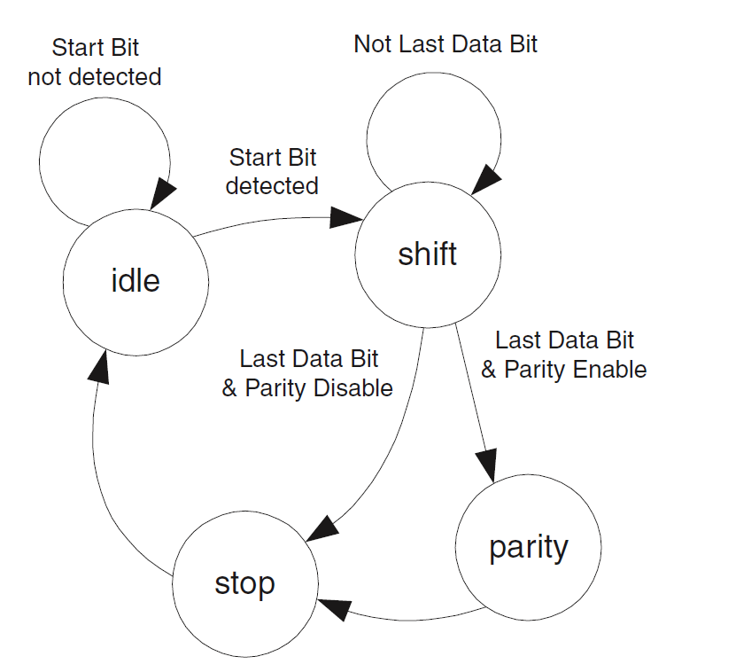
Design
FSM Diagram
Idle:
Reset Button will reset machine to this state.
In this state, receiver is waiting for SER_IN to go from high to low i.e. start bit. After successful detection, it will shift to <shift> state.
Shift:
When Receiver is in this state, it waits for 1 clock cycle for each data bit to shift.
After last Data bit is shifted in the receiver will switch to <parity> state if parity is enabled.
Otherwise it will switch to <stop> state

Slide 10
Design
FSM Diagram
Parity:
When the FSM is in this state, it waits for next clock cycle and then samples parity bit.
Once it is sampled it will switch to <stop> set.
Stop:
FSM will wait for 1 clock cycle and then samples the stop bit.
The FSM switches back to <idle> state after the Stop bit sampling

Slide 11
VHDL Code
Entity Declaration for CLK16
library IEEE;
use IEEE.STD_LOGIC_1164.ALL;
entity CLK16 is
port (CLK : in std_logic;
enable: in std_logic:='0';
CLK16x : out std_logic := '0');
end CLK16;
architecture Behavioral of CLK16 is
signal currentCLK16x : std_logic :='1';
signal count : integer := 16;
Ports Required:
CLK: Clock input
CLK16x : Output Port which changes values at every 16 counts. This is input for Receiver

Slide 12
Architecture Block of CLK16
VHDL Code
begin
process(CLK, enable)
begin
if enable=‘1’ then
if Rising_edge(CLK) then
if count=16 then
currentCLK16x <= not currentCLK16x;
CLK16x<=currentCLK16x;
end if;
count <= count-1;
if count=0 then
count<=16;
end if;
end if;
end if;
end process;
end Behavioral;

Slide 13
VHDL Code
Entity Declaration
library IEEE;
use IEEE.STD_LOGIC_1164.ALL;
entity UART_Receiver is
port(SER_IN : in std_logic := '1';
RESET : in std_logic;
OUT16O : out std_logic_vector(15 downto 0):=(others=>'0');
CLK : in std_logic;
statusOUT : out std_logic :='0';
ERROR: out std_logic := '0');
end UART_Receiver;
Ports Required:
CLK: Clock input for UART. Which is defined Baud rate.
RESET: Asynchronous RESET Signal
SER_IN: Serial bit stream received by unit
ERROR: Output goes ‘1’ for Parity Error or Not getting Stop Bit after 16-bit
statusOUT: Shows current status. For busy condition gives output ‘1’
OUT16O: Output Bit vector in parallel form

Slide 14
Architecture Block of UART_Receiver
VHDL Code
architecture Behavioral of UART_Receiver is
signal status : std_logic := '0';
signal par : std_logic := '0';
signal OUT16 : std_logic_vector(15 downto 0):=(others=>'0');
signal CLK16x : std_logic;
signal count : integer := 0;
component CLK16
port(CLK: in std_logic;
enable: in std_logic:=‘0’;
CLK16x: out std_logic);
end component;
begin
CLKP : CLK16 port map(CLK, status, CLK16x);
pmain : process(RESET, SER_IN, CLK16x, CLK)
begin
if RESET='1' then
OUT16O <= x"0000";
OUT16 <= x"0000";
ERROR <= '0';
count<=0;
par<='0';
status<='0';
statusOUT <= '0';
Reset Block

Slide 15
Start Bit to Parity bit Sampling
VHDL Code
elsif CLK16x'event and CLK16x='1' then
if status='0' and SER_IN='0' then
status<='1';
statusOUT <= '1';
count <=0;
Getting Start Bit
elsif status='1' and count<16 then
count <= count+1;
OUT16 <= OUT16(14 downto 0) & SER_IN;
if SER_IN='1' then
par <= not par; --EVEN PARITY
end if;
elsif count=16 and status='1' then
count<=17;
if SER_IN=(not par) then
ERROR <= '1';
OUT16 <= x"0000";
end if;
Counting up and
Shifting one bit to right until count reached to 16
Update Parity if Input is ‘1’
Check parity at last input i.e. count=16

Slide 16
Sampling Stop bit and shift to IDLE state
VHDL Code
elsif count=17 and SER_IN='1' and status='1' then
--at 17th count, check for SER_IN=1 for IDLE and reset
OUT16O <= OUT16;
ERROR <= '0';
status<='0';
statusOUT<='0';
end if;
elsif count=17 and SER_IN='0' and status='1' then
OUT16O <= x"0000";
ERROR <='1';
status<='0';
statusOUT<='0';
end if;
end process;
end Behavioral;

Slide 17
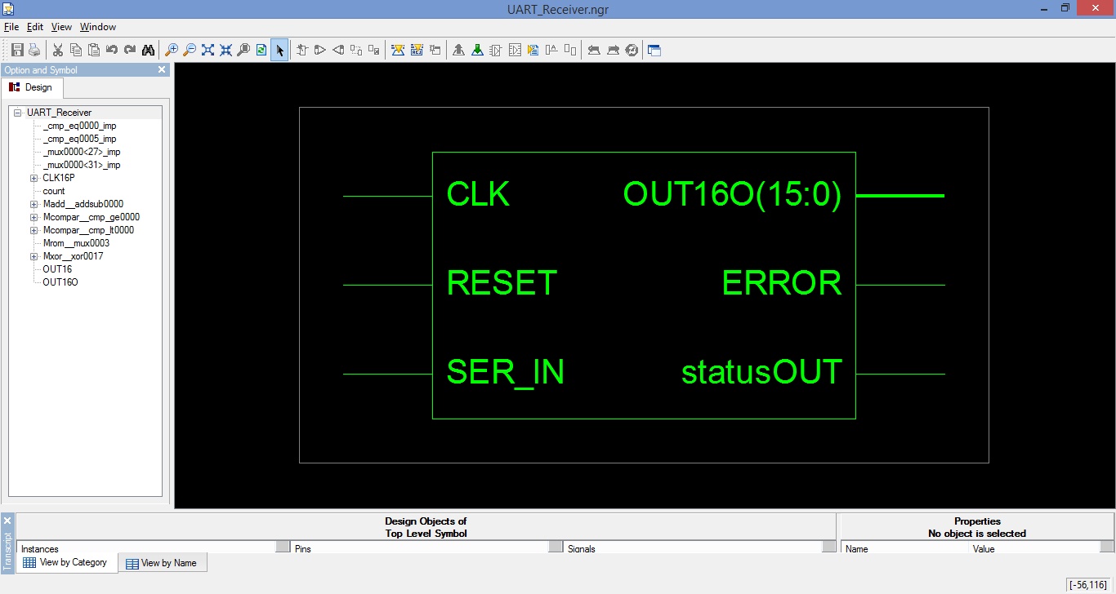
RTL Schematic : Block Diagram

Slide 18
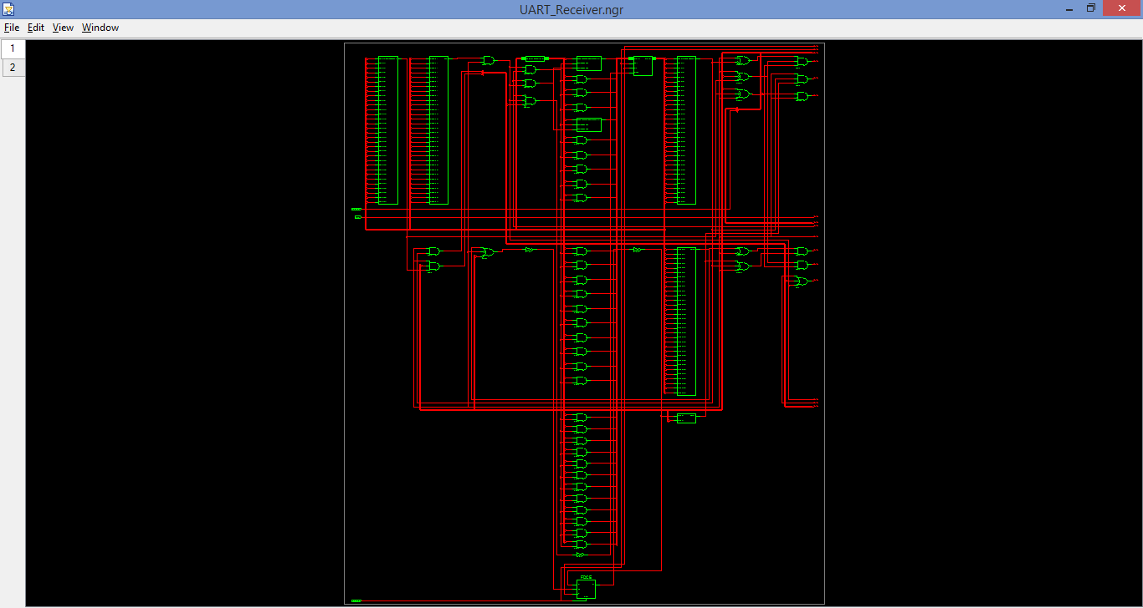
RTL Schematic : Inside Block Pg. 1

Slide 19
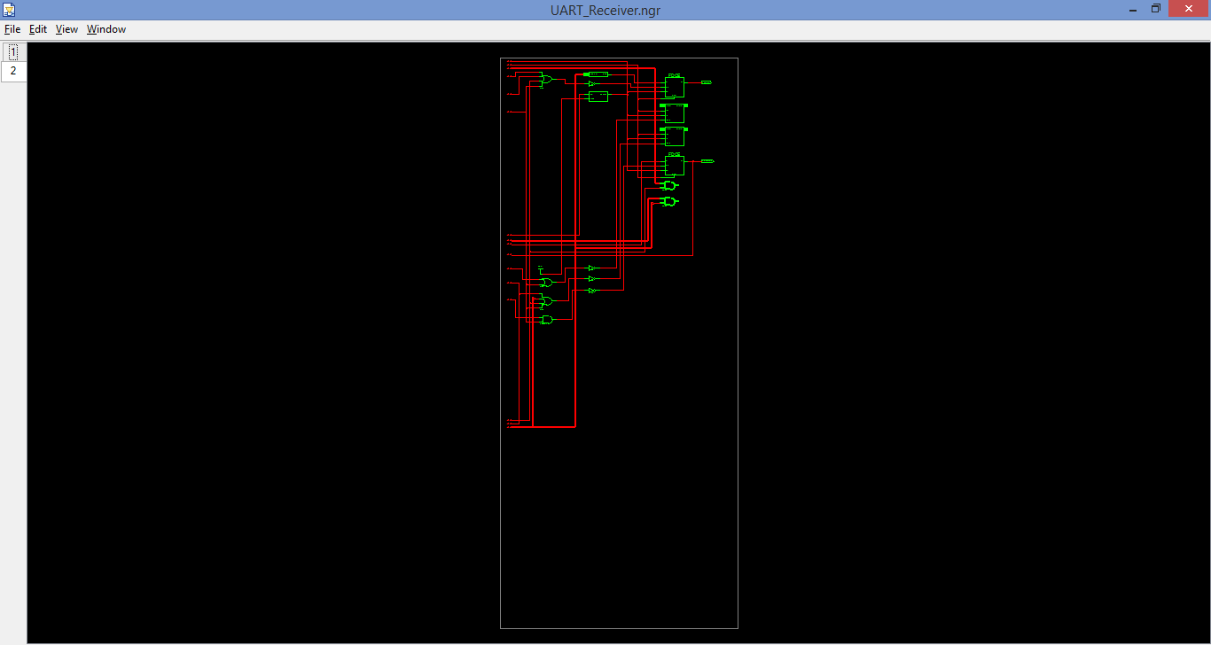
RTL Schematic : Inside Block Pg. 2

Slide 20
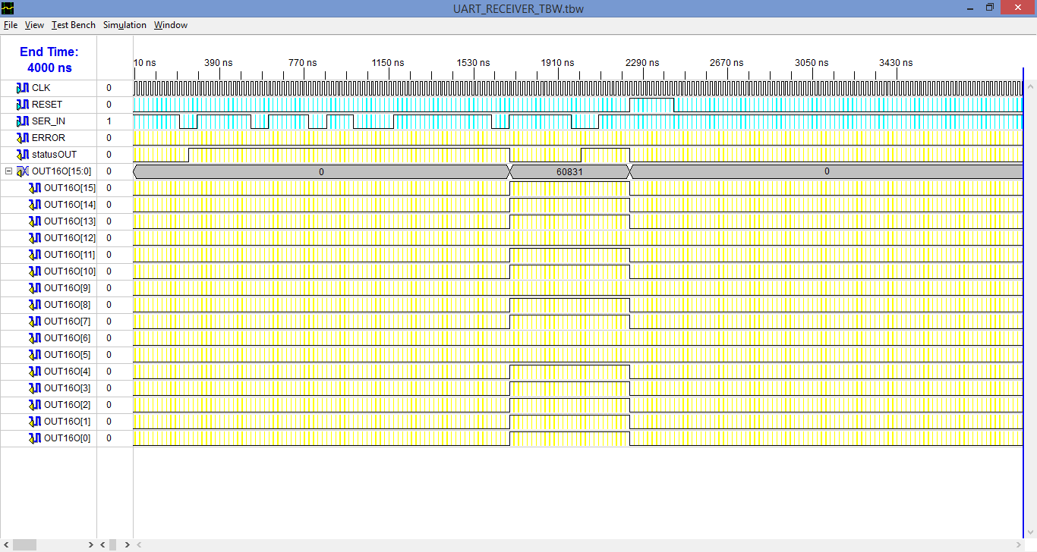
Simulation Results
For simulation Purpose, we have used 2 times baud rate as Clock

Slide 21
Summary
UART Receiver is designed using VHDL and tested successfully on test bench simulation.
Here clock cycle can be replaced by Baud Rate Pulses generated by Baud Rate Generator to accurately synchronise with Transmitter.

Slide 22
Thank you

